Slide 1
Python for datascience
Final Assignement
Grégor JOUET
Dataset: Cardiotocographic data
2126 measurements and classifications of foetal heart rate (FHR) signalsaphic data

Slide 2
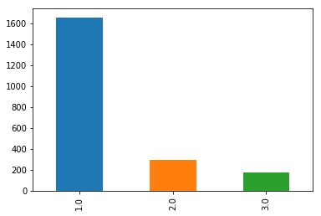
The Dataset
High level features of foetal heart rates: frequency bounds, accelerations, additional information like foetus movement.
Multiple classification targets, most interesting is CLASS indicating of the foetus is healthy or has a heart disease.
The class repartition of the dataset shows an over-representation of the 'healthy' class compared to the other classes.
Probably because the majority of the foetus tested were healthy, this could be a problem when we build our model

Slide 3
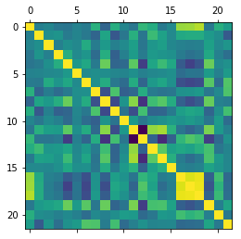
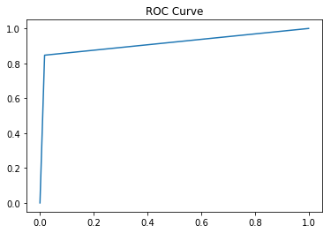
The models
Because of the classes repartition and the presence of key features such as ASTV as we can see in the correlation matrix
The ASTV, abnormal heart rate observation, is strongly correlated
to the 'healthy' / 'pathologic' class.
Because of that, a decision tree with a grid search seems like a good idea. I later tried a xgboost and had a classification of 91%
The ROC Curve confirms the validity of the model.

